Slide 1
Evolution of Cooperation
Social Organization

Slide 2
Evolution of Cooperation

Slide 3
Cooperation / Evolution & Cooperation
EVOLUTION
Dictates that the most resourceful reproduces more often, allowing such genes to dominate a population. Consequently, seldom should traits of “free help” be seen
There is space for mutually beneficial interactions between two actors or even species
To understand mutually beneficial interactions (or cooperation), these should be analyzed from the eyes of all actors over time, where time could be generations
COOPERATION
The process of consciously working together, or unconsciously working in harmony in a manner where all actors involved in the work gain a benefit
There are thousands of simple examples of cooperation in nature and biology, but human cooperation is one of the most complex
Unlike the world of physical-evolution where the fittest survives, in a cooperative-evolutionary environment the most cooperative survive or dominate

Slide 4



Cooperation / Cooperation as Subconscious
Why do some see it a duty to sacrifice themselves in order to help others succeed, or to pursue a greater goal?
Fukushima’s Gate
Open Source
Environmentalists
Physical Sacrifice
Intellectual Donation
Career Focus
Everyday we see examples of individuals among us that rise up and sacrifice themselves, donate their knowledge, or their career in pursuit that does not maximize their wealth as an individual, but rather, increases the quality of life of the whole

Slide 5
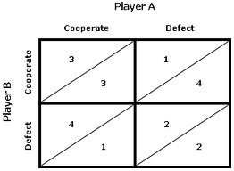
Cooperation / Prisoner's Dilemma
Prisoner's Dilemma – A way to simulate the results of collaboration versus defection on a set of individuals or community

Slide 6


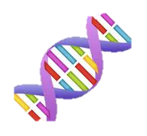


Cooperation / Fives Types
Nowak in “Evolution of Cooperation” summarizes five types of collaboration that appear in evolution
Direct Reciprocity
Spatial Selection
Kin Selection
Indirect Reciprocity
Group Selection

Slide 7
Cooperation / Direct Reciprocity
Direct Reciprocity – “I scratch your back, you scratch my back soon…”
“The vampires live in stable groups and return to the roost every day after hunting, so group members routinely encounter one another.
Studies have shown that the bats remember which bats have helped them in times of need, and when the day comes that the generous bat finds itself in need of food, the bat it helped earlier is likely to return the favor.”

Slide 8
Cooperation / Spatial Selection
Spatial Selection – Groups of cooperators can beat defectors in a population
Yeast in populations can be described as cooperators and defectors. Cooperators generate an enzyme that helps digest foods. Defectors do not create these enzymes, but do use them.
“Among yeast grown in well-mixed populations defectors prevail. In populations with clumps of cooperators and defectors, in contrast, the cooperators won out.”

Slide 9

Cooperation / Kin Selection
Kin Selection – Individuals sharing genes sacrifice for one another
“Although one may be reducing one’s own direct reproductive fitness by assisting a relative in need, one is still fostering the spread of those genes the helper shares with recipients”
“I will jump into the river to save two brothers or eight cousins” -- Haldane

Slide 10


Cooperation / Indirect Reciprocity
Indirect Reciprocity – One individual decides to aid another based on the needy individual’s reputation
“Those who have a reputation for assisting others who fall on hard times might even find themselves on the receiving end of goodwill from strangers when their own luck takes a turn to the worse.”
Instead of “I’ll scratch your back if you scratch mine” mentally, the cooperator in this situation might be thinking, “I’ll scratch your back, and someone will scratch mine.”

Slide 11
Cooperation / Group Selection
Group Selection – A group’s survivability is improved when individuals sacrifice themselves for the group
“A tribe including many members who … were always ready to aid one another, and to sacrifice themselves for the common good, would be victorious over most other tribes; and this would be natural selection.”
“Thus, employees of a company compete with one another to move up the corporate ladder, but they also cooperate to ensure that the business succeeds in this competition with other companies.”

Slide 12





Cooperation / Humans & Cooperation
Humans mostly cooperate via indirect reciprocity, or reputation
HUMAN EFFECTS
DRIVERS FOR COOPERATION
Reputation predominantly drives where humans invest their energy
Public acts of cooperation: people are more generous when they feel watched
i.e.: Toyota & Suppliers in the ‘80s
People are most generous when their reputation also increases with their generosity
Because of cooperators and defectors, human collaboration goes up and down
This is because trust takes time to develop

Slide 13
Social Organization

Slide 14
Mass Collaboration / Human Cooperation, Collaboration & Mass Collab.
COOPERATION
Evolutionarily nature forced humans to cooperate to survive
COLLABORATION
Collaboration is the act of choosing to cooperate, when such is not required. Fungi and roots can only cooperate, whereas humans can collaborate
All forms of collaboration require an end goal, purpose, or vision
MASS COLLABORATION
Working with many in a collaborative environment leads to mass collaboration
In mass collaboration environments three main elements are needed: a media to collaborate, a community, and a greater purpose
For online mass collaboration to be successful it also needs to fulfill six principles: participation, collective, transparency, independence, persistence, and emergence

Slide 15
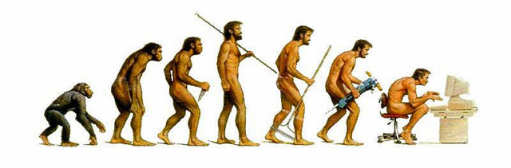
Mass Collaboration / Evolution of Cooperation
Nature forced humans to cooperate, later we optionally collaborated, now we can mass collaborate to over come larger challenges
Cooperation
Collaboration
Mass Collaboration

Slide 16



Mass Collaboration / Media, Community, and Purpose
In human history plenty are examples of collaboration – more visible is the chaos that emerges when collaboration and unity disappear
Media
Community
Purpose
Enabler of communication. Either a physical location or tool
The individuals as a unit
Final goal which no one individual can achieve, but the community can
Both an attractant and a value creator
The outcome of the mixture of the media, community and purpose of a collaborative environment is “culture.”

Slide 17






Mass Collaboration / Six Principles
Aside from incentives to drive collaboration, in online media six principles are needed to create productive mass collaboration environments
PARTICIPATION
INDEPENDENCE
Mobilize community to actually participate
Asynchronous media. Allowing anyone, anyplace, anytime to interact
COLLECTIVE
EMERGENCE
Contribute to the whole rather than distribute individually
Behaviors can not modeled and controlled. New cultures and mechanism will emerge. Accept it.
TRANSPARENCY
PERSISTENCE
Everyone can see everyone and their contributions – given a certain level of privacy
Information should be available for historic reference

